Slide 1


Faculty of Business and Technology Information Technology Program ITE499 – Internship (Inter Program) Semester 3 /2022 Lecturer: Dr. Surekha Lanka WEB DEVELOPMENT, WEB DESIGN, AND WEB WRITING CONTENT CREATION INTERNSHIP
Student Intern: Fardina Kabir 1910080005
Internship Company Supervisor: Daniel Parsons

Slide 2
Company Info: TBS Marketing
TBS Marketing is a dynamic marketing agency headquartered in Bangkok, Thailand.
With a team of passionate marketing professionals and web developers, the company fosters a culture of collaboration, creativity, and innovation.
TBS Marketing offers a wide range of services, including branding, digital marketing, website design and development, social media marketing, and event management. They work with clients from diverse industries such as hospitality, finance, healthcare, and more.
Committed to helping businesses grow, TBS Marketing specializes in providing effective marketing strategies and tailored solutions to meet the unique needs and goals of their clients.

Slide 3
Issues In Implementing
Solution Approach
Communication Challenges: As an intern, clear instructions and effective communication are essential for performing tasks efficiently. Language barriers & unclear instructions sometimes led to miscommunication, resulting in confusion and delays.
To address communication issue: I actively sought clarifications, asked for feedback, & express any concerns to ensure a better understanding of the assigned tasks.
Technical Challenges Working with WordPress and other web development tools presented technical challenges. Issues such as plugin compatibility, website performance optimization, and troubleshooting website problems required research and assistance from senior developers.
Solutions I needed to develop problem-solving skills and became more resourceful in finding solutions via research.
Improving my time management skills I had to prioritize tasks, allocate time efficiently, and ensure the delivery of high-quality work within specified timeframes.
Time Management Managing multiple projects and deadlines posed challenges, particularly when unexpected tasks or revisions arose.

Slide 4

CONTENTS
Web
Development
Web
Design
Web
Writing Content Creation
Part 1
Part 2
Part 3

Slide 5
Part I: Web Development
I completed development of 36 sites so far.
Before Development, Check PBN from Trello, Add sites to Launch CDN, Copy name servers from the CDN to the corresponding domain hosting of the site.
During middle of development, install the required plugins, update discussion settings that also includes permalinks, create 4 categories based on the topic of the sites, generate 3 writing content for every site, every content requires to be under two categories and one of the two categories will be common for every post as a standard format. Choose a suitable theme based on topic, flexibility, and customizability. Then do footer sections, sidebar section, contact page, about page, & Privacy Policy page. Update CSS code to alter copyright names or change theme elements or colors when required. Complete logo Design
At the end of Development, add sites to CRM of TBS Marketing that require getting unique ID from the TBS Child plugin that was installed for Indonesian site and fathon ID for UK site using the Fathom site. After adding to CRM, add DR, complete redirection using HREF website. From href sites, I need to get details that I downloaded as an excel output, where after download I do some editing, such as replace some information with the site url and then save the file in comma delimited file format and then reupload them in the redirection section.
Finally, the site development and design is completed and ready to be delivered.

Slide 6
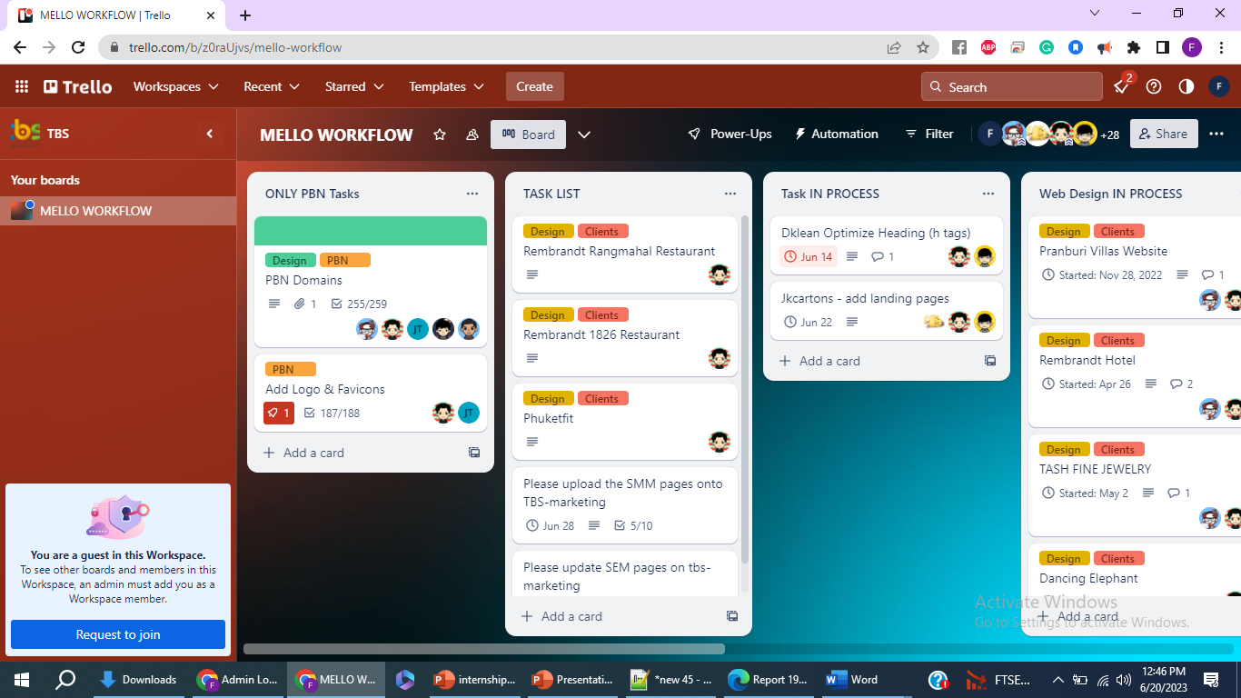
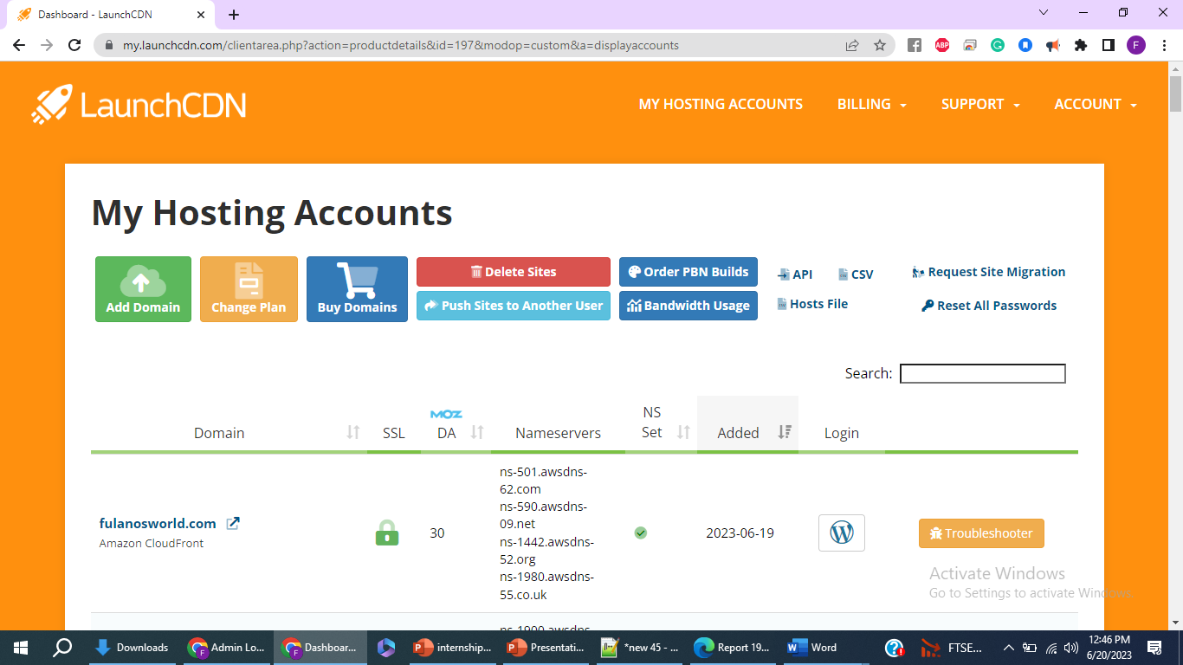
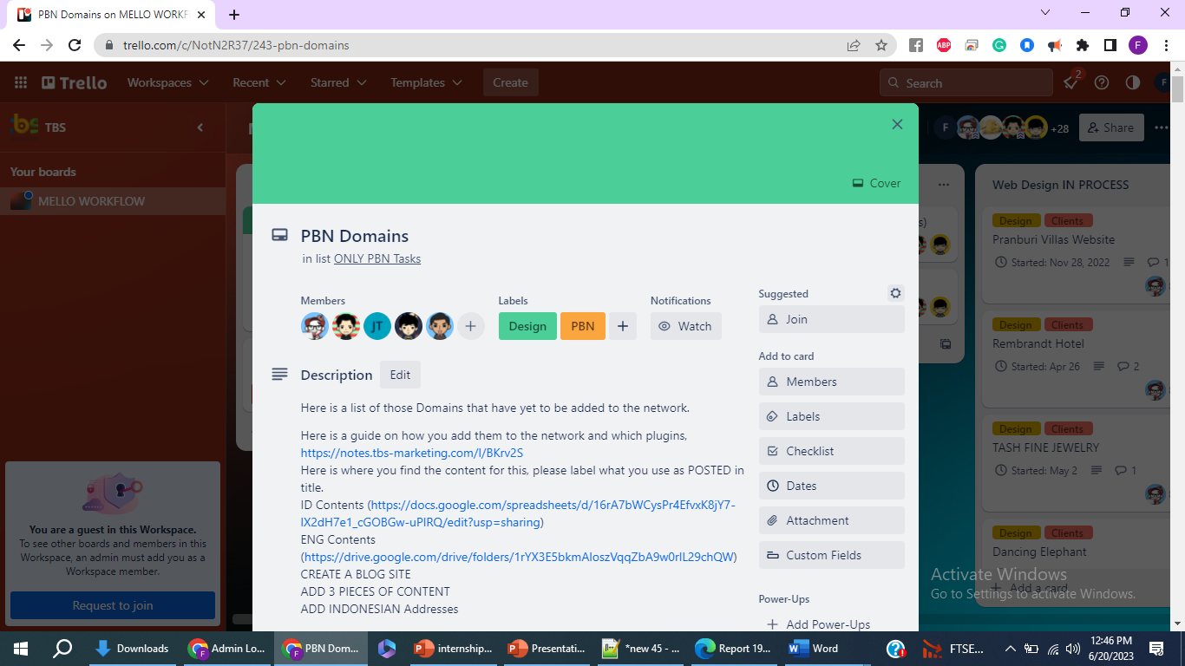
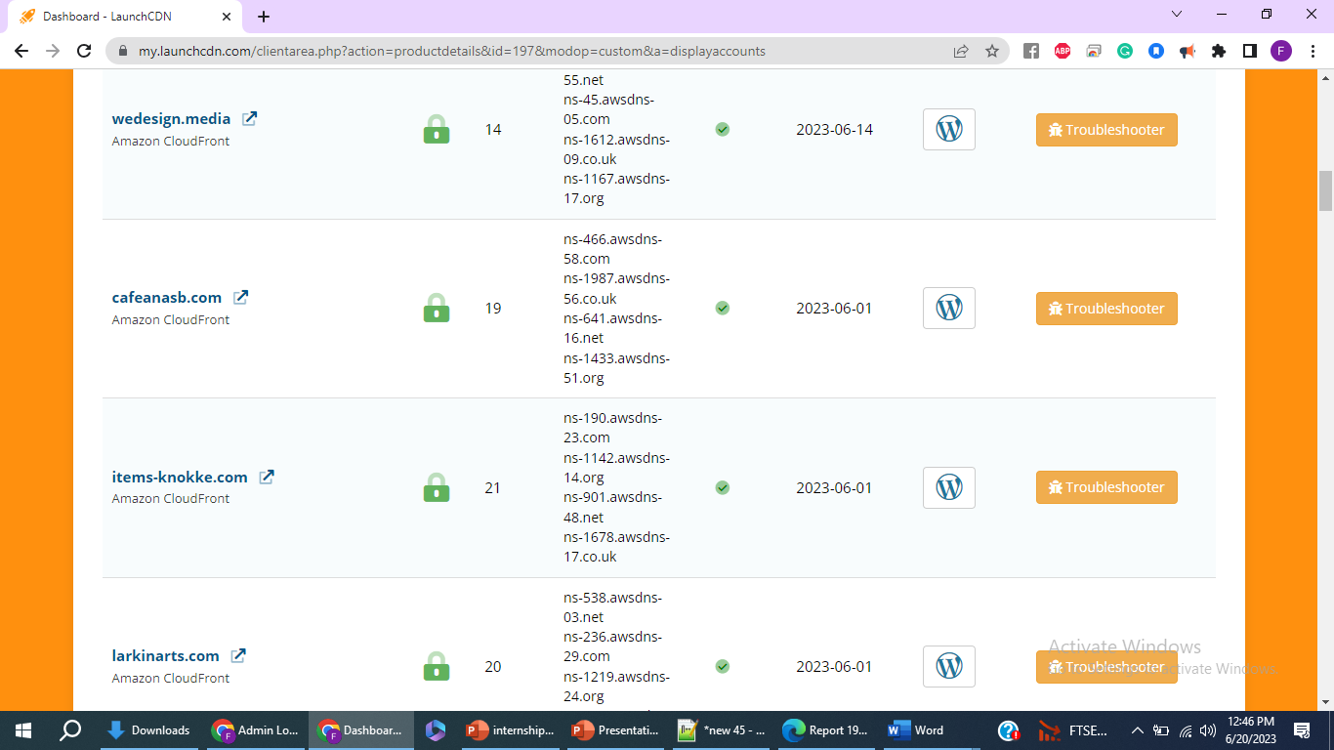
Before Development
TRELLO
LaunchCDN

Slide 7
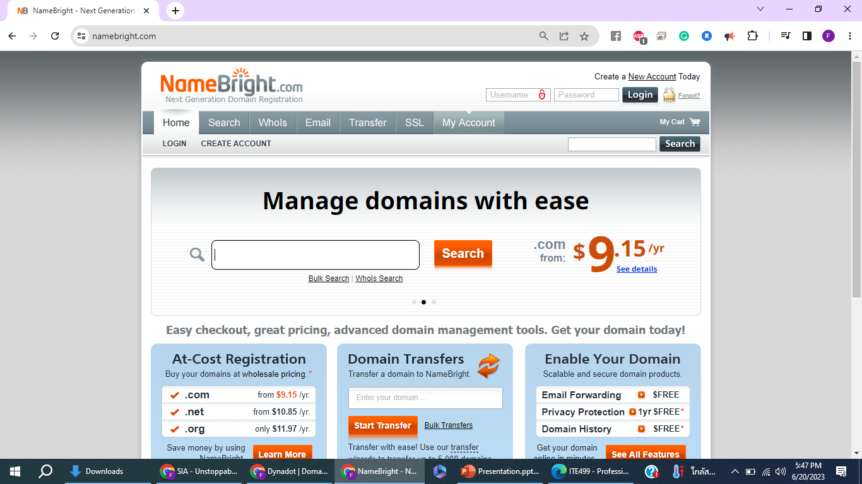
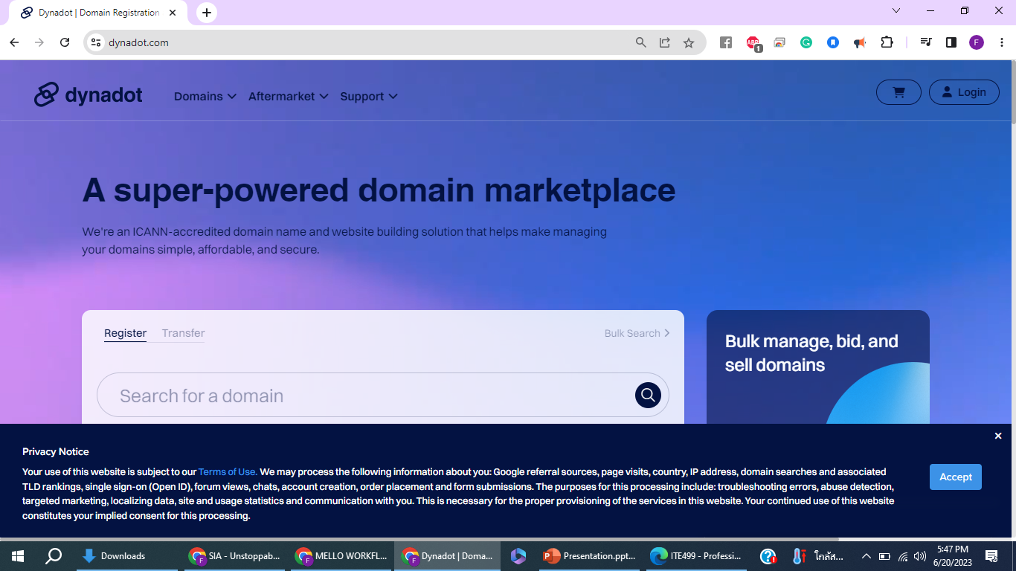
Domain Hostings
e.g., NameBright, SAV, NameCheap, GoDaddy,
DynaDot,Gname, and othe relevant..

Slide 8
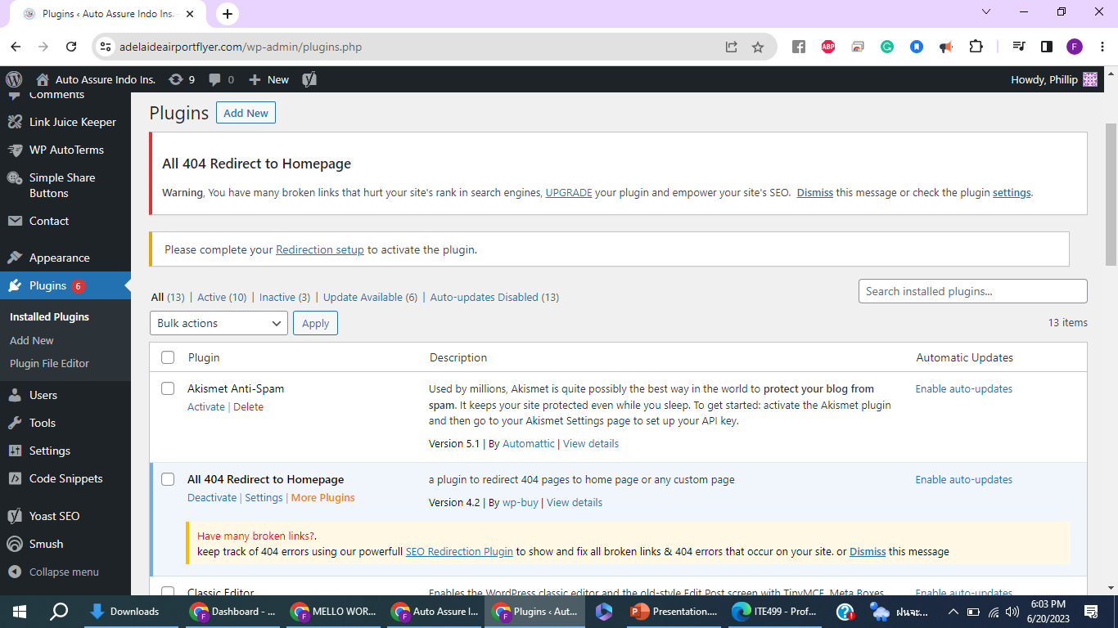
Middle of Development involves working at the Wordpress Dashboard

Slide 9
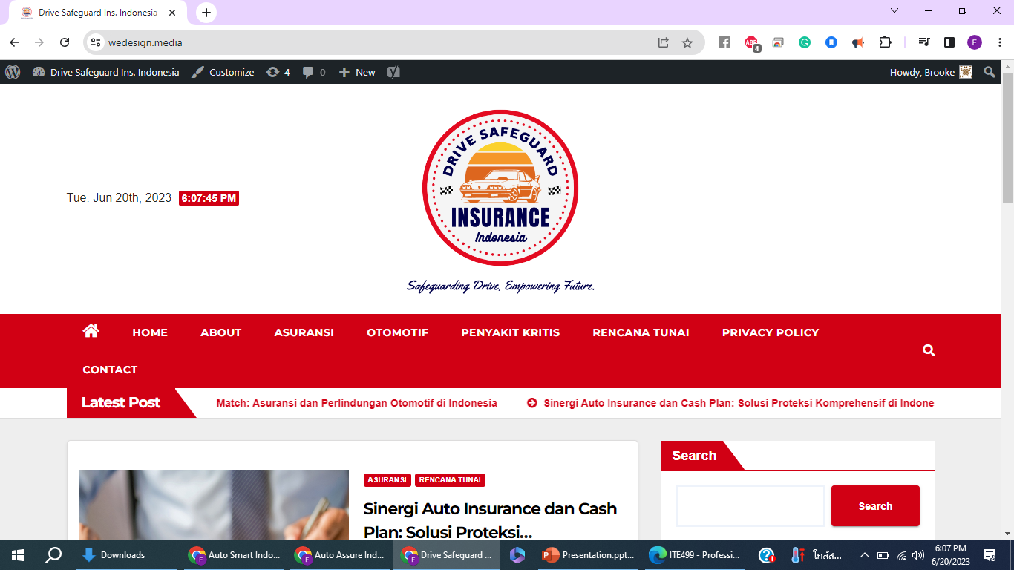
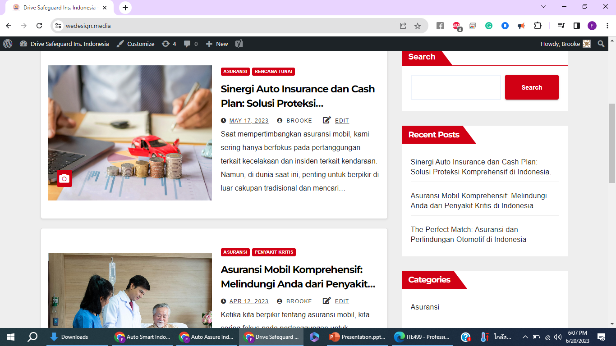
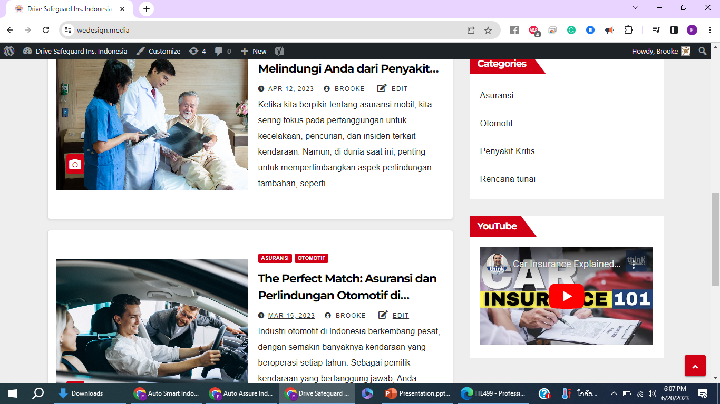
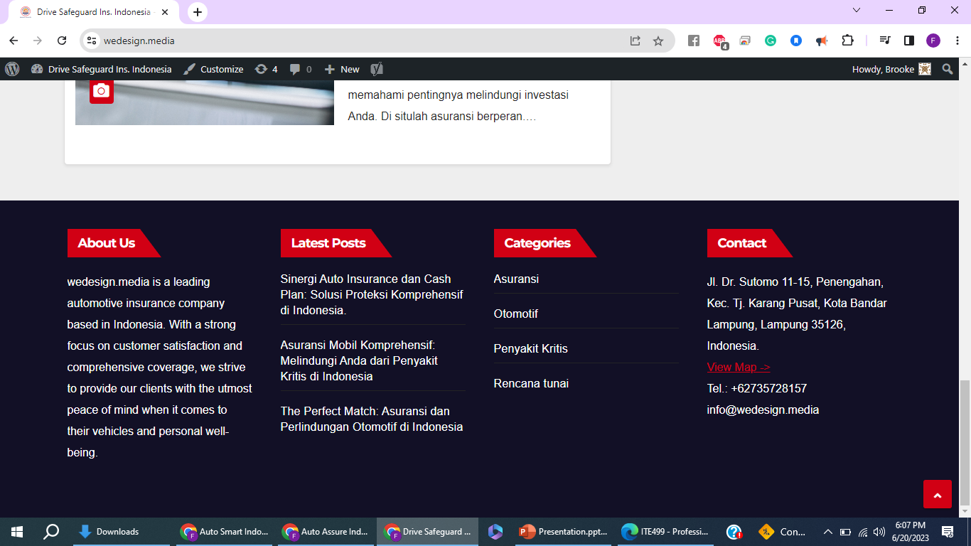
Completion of the middle stage of Web development includes:

Slide 10
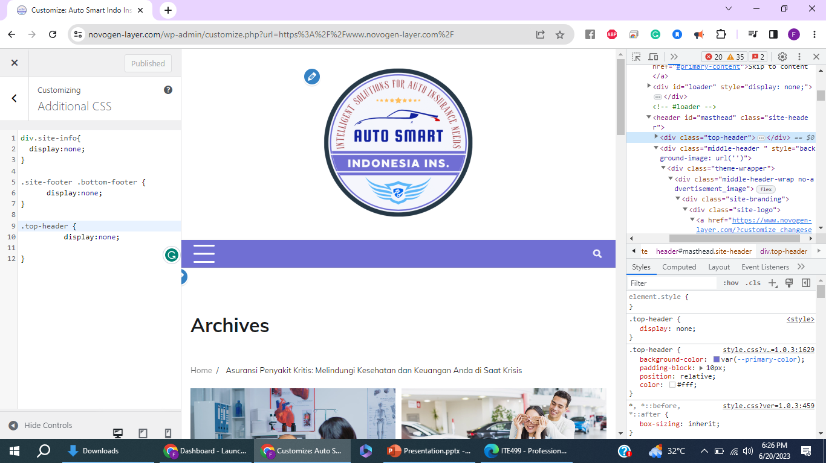
Alteration with CSS on a WordPress site

Slide 11
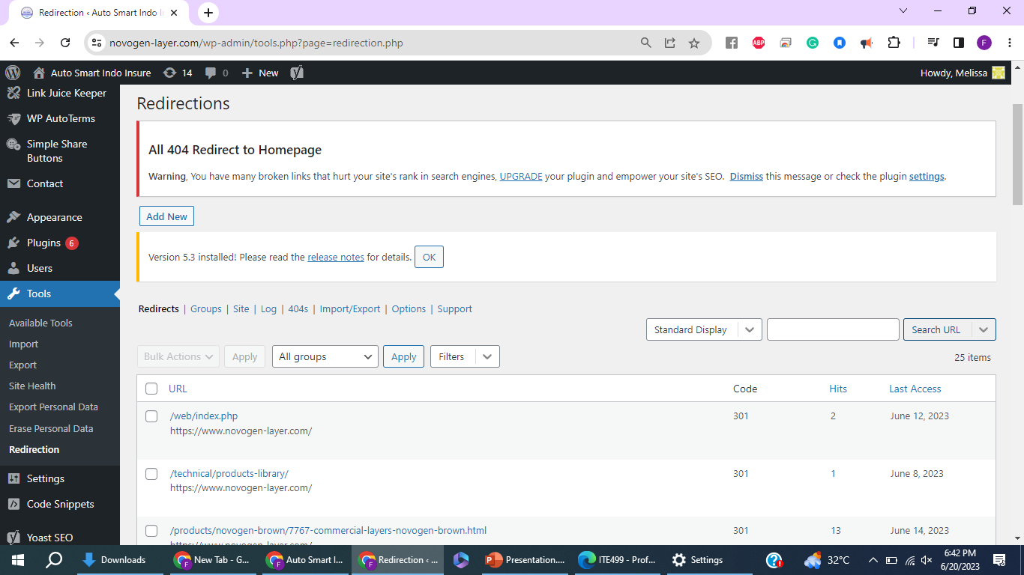
Last Stage of Web Development involve using ‘href’ named website for setting up redirection at the Wordpress dashboard

Slide 12
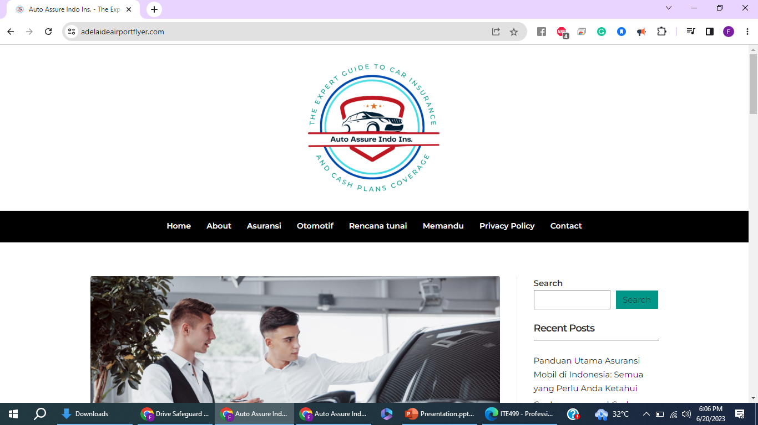
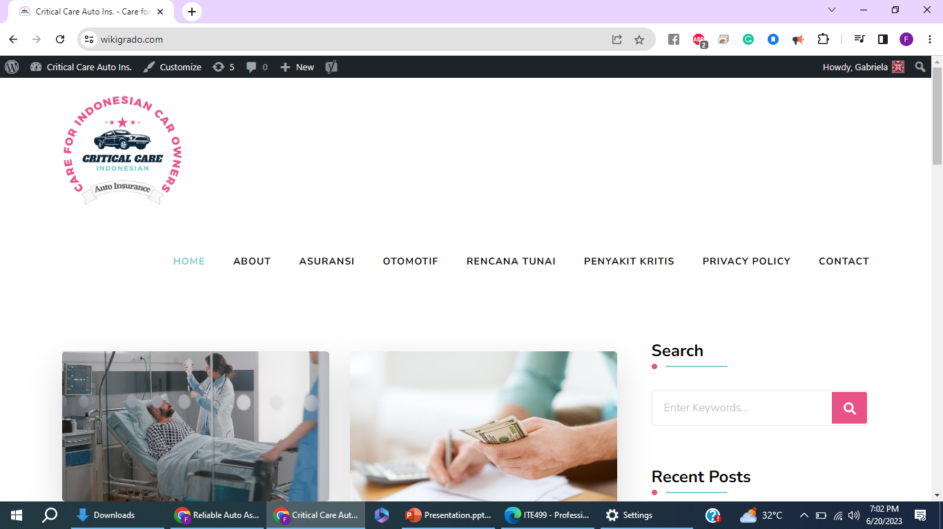
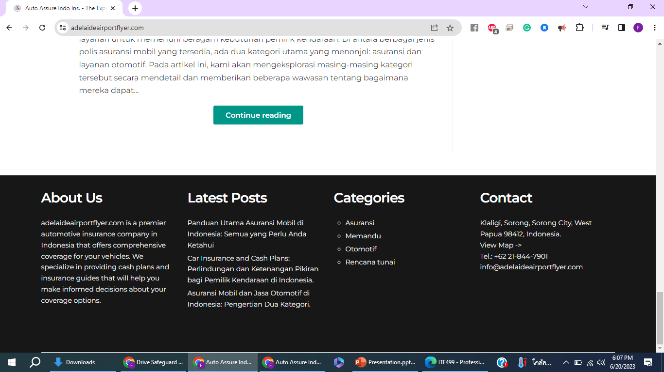
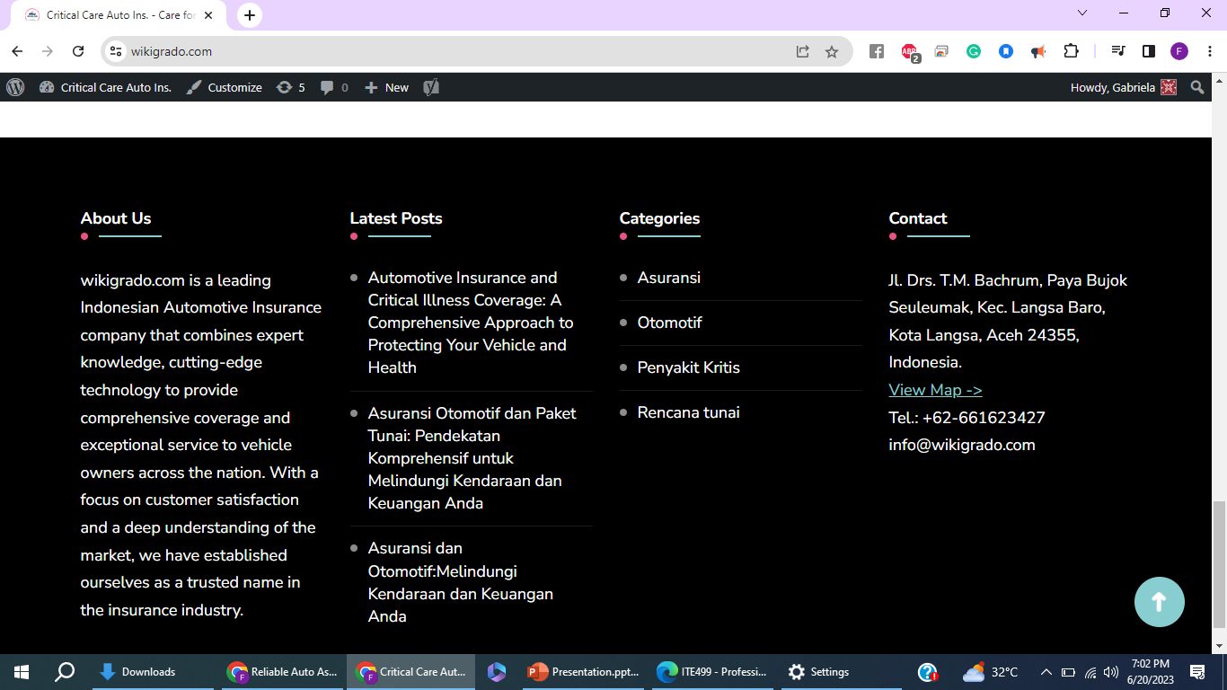
E.g. of some completed web development sites

Slide 13
Some other web development projects other than developing sites from the PBN list, included:
Updating three big sites, i.e. prestigeproperties.com, uct-asia.com i.e the procurement business, and the STM-style blog for the cosmetic surgery clinic, Michael Tailor’s website, Pattaya Prestige properties website, Summedico Website,& REMBRANDT Hotel site.
To assist two senior web developers that they were working on so that we could complete them as soon as possible within the deadline of the projects.
Involved tasks such as posting writing content provided to me by writers from the company , also Images, other media files as well, and use category appropriately, and other relevant standard measures set by senior developers.

Slide 14

Part II: Web Design & Web Logos
I completed around 80 logo creation/design for sites at TBS using Canva. I created logos for the site using Canva website of TBS Marketing that has access to all premium features. I create a logo with various elements, designs and color styles that goes aesthetically well with the website theme.
At the end of the second internship month, I was assigned a different task that needs to create a similar design from Figma into the local WordPress site using Beaver Builder themes and its plugins as directed by my senior.

Slide 15
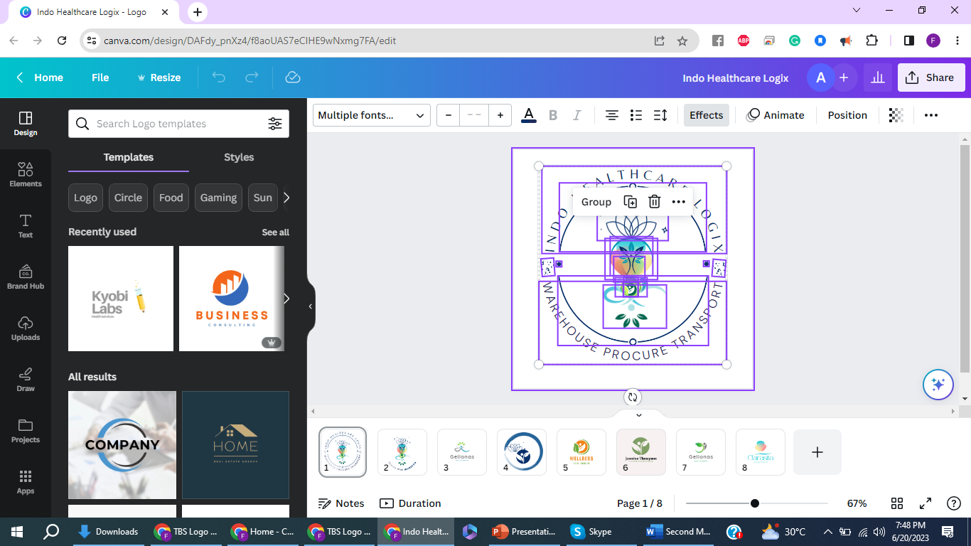
Using Canva for Creating Web logos

Slide 16
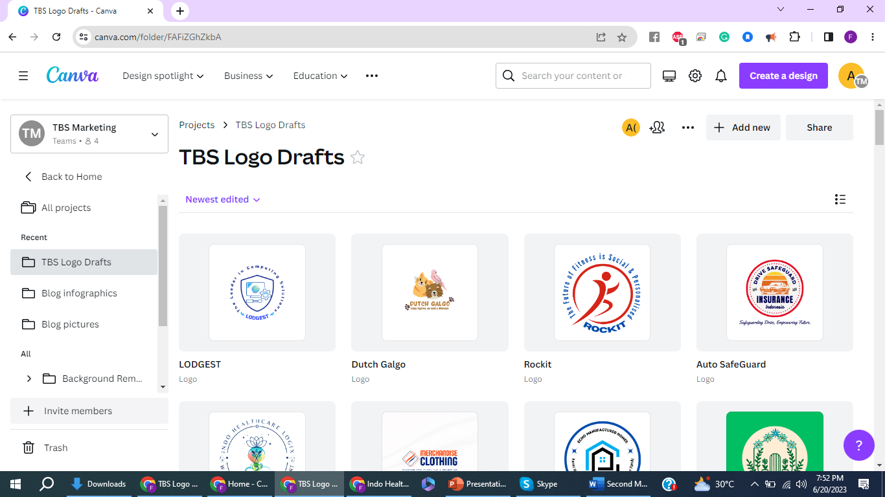
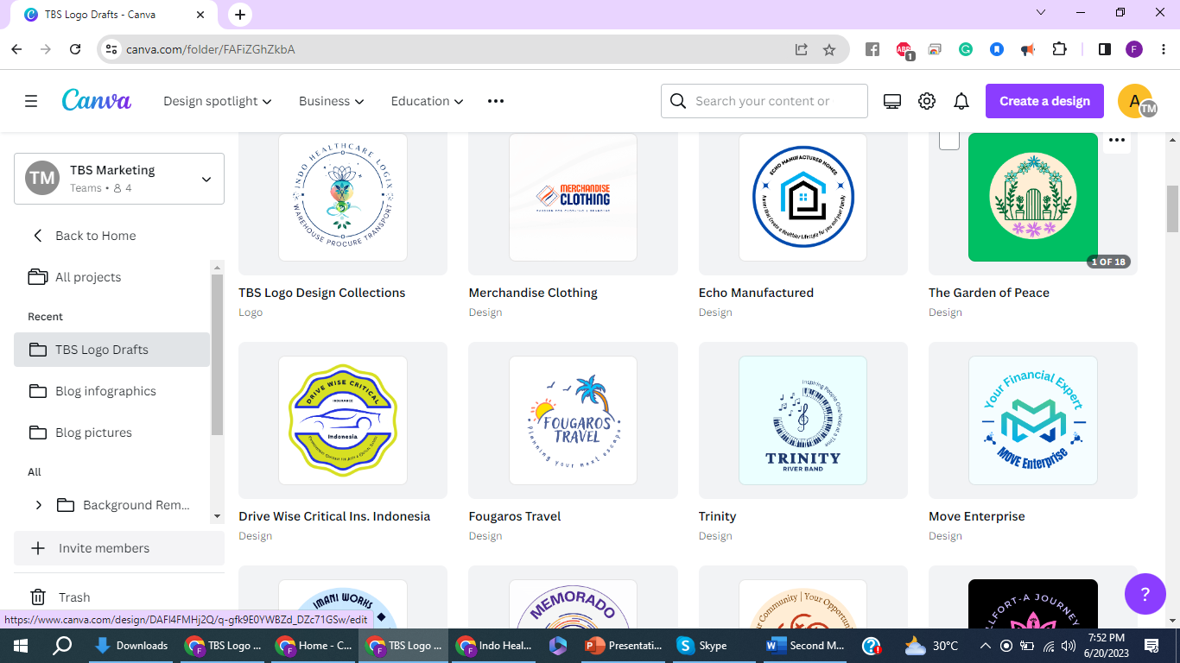
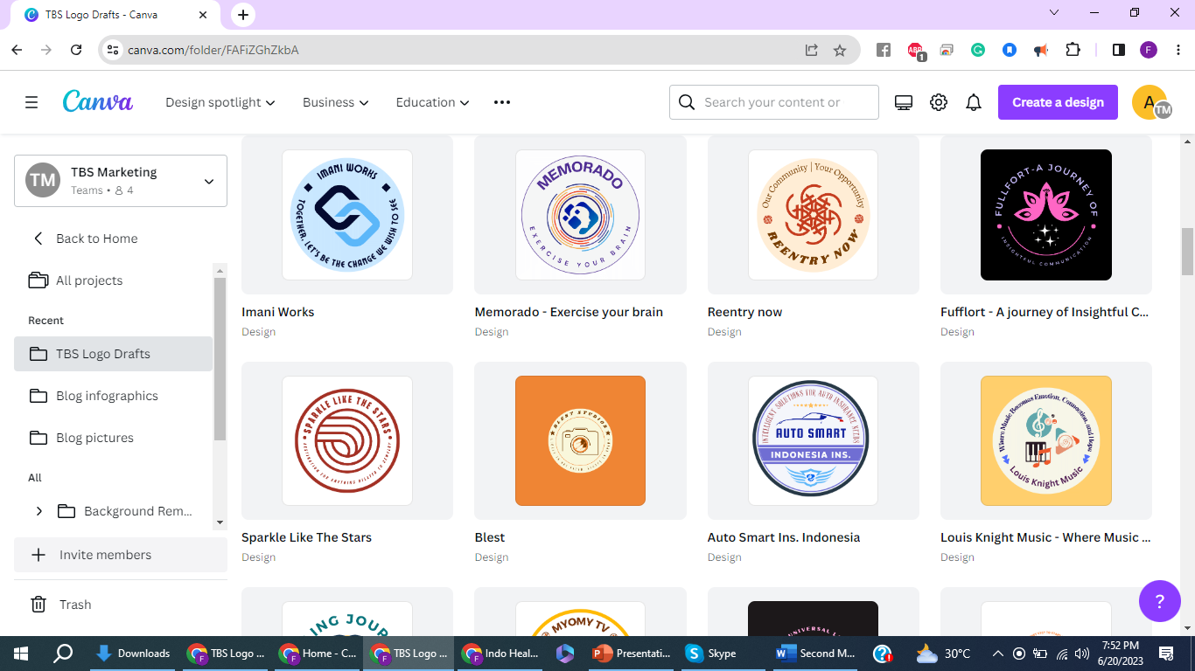
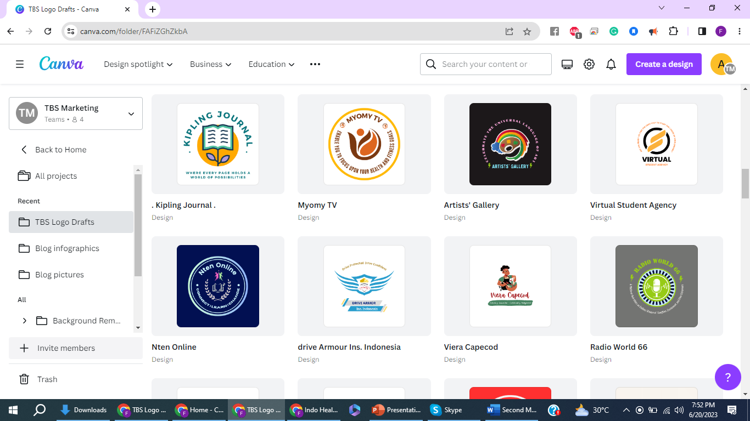
E.g., of some Logos I designed so far using Canva

Slide 17
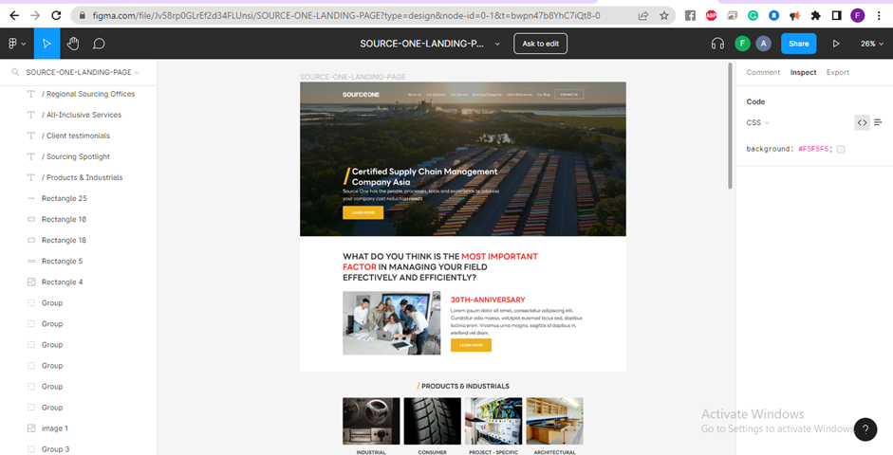
Using Figma for SourceOne Website

Slide 18
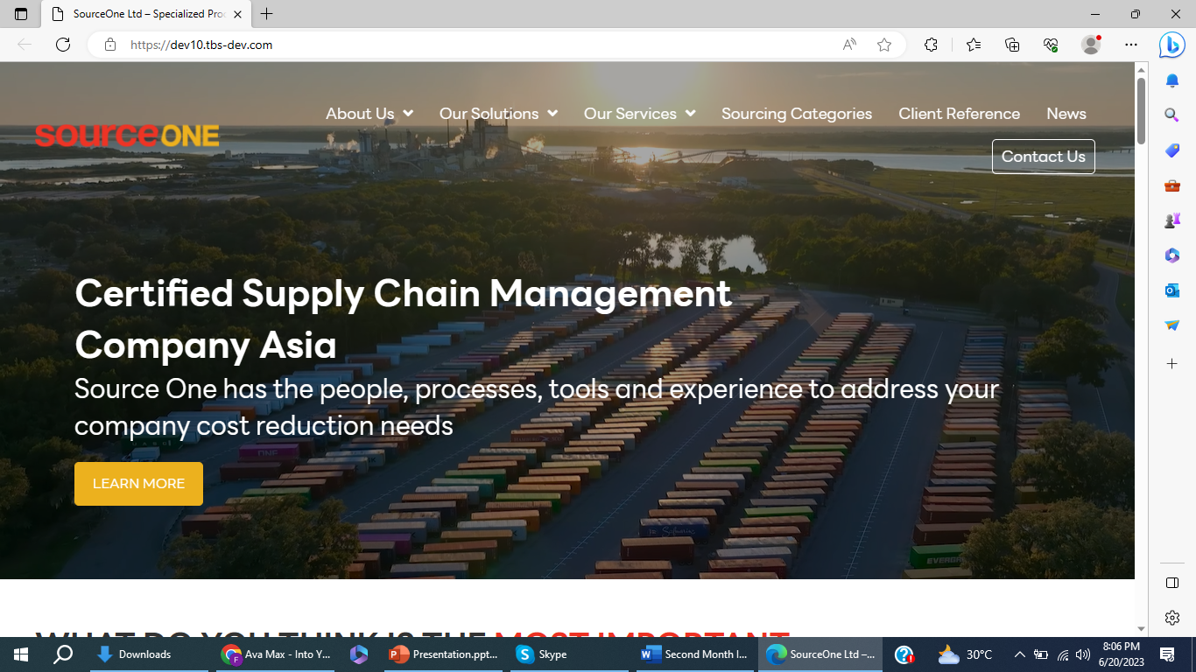
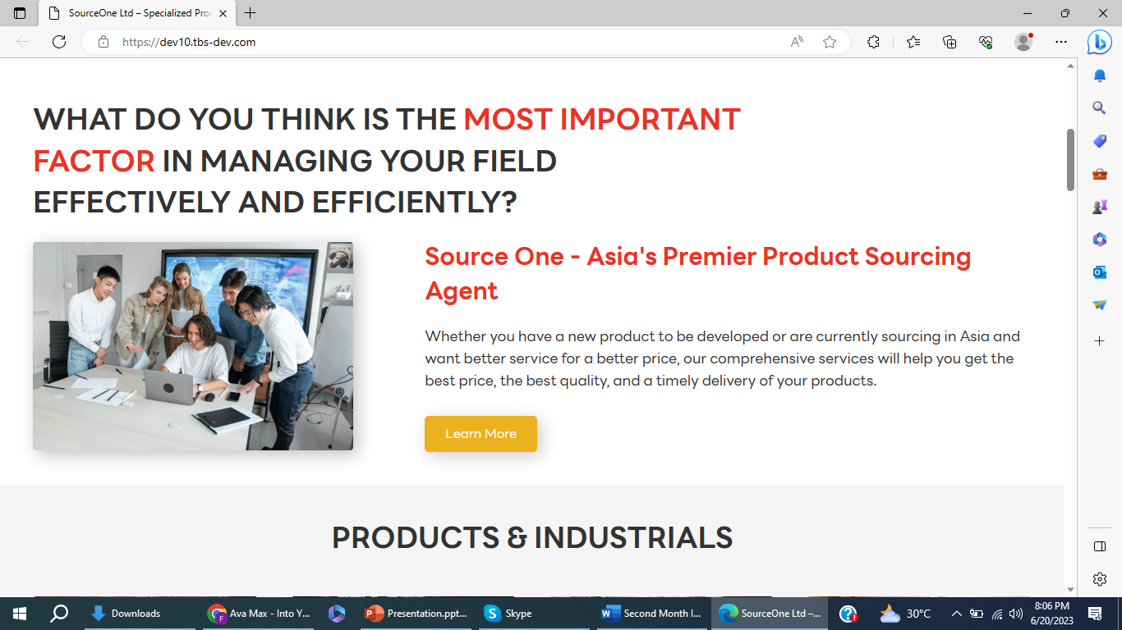
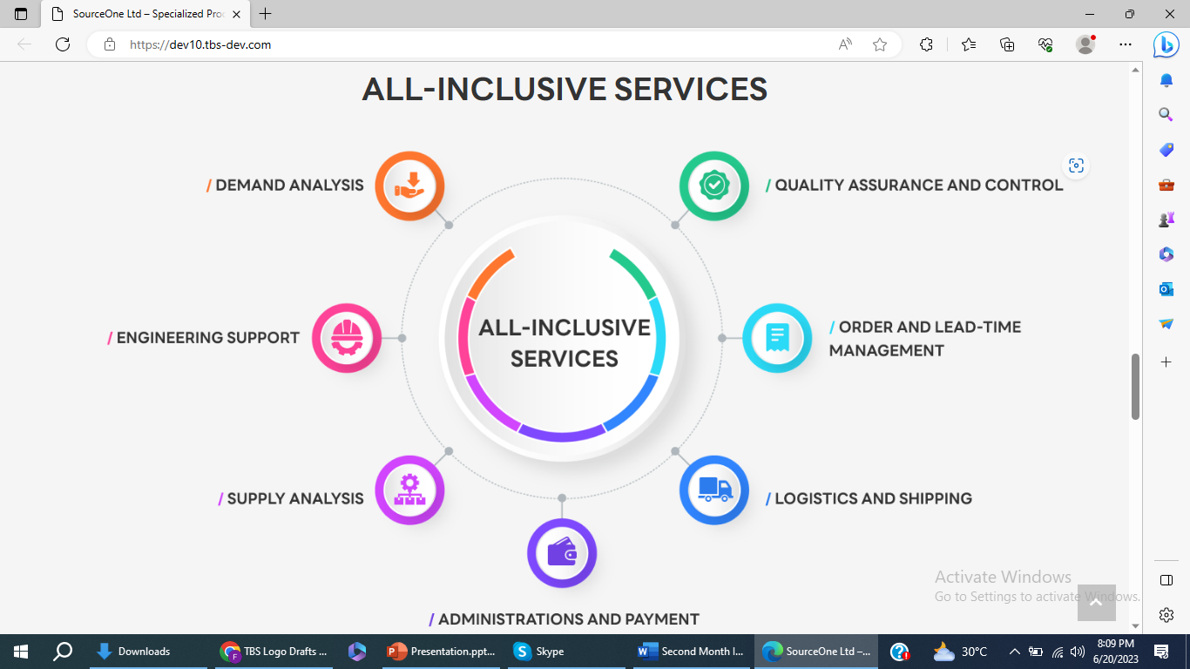
Create a similar design from Figma into local WordPress site using Beaver Builder themes and its plugins as directed by my senior for Web UX/UI testing.

Slide 19
Part III: Web content creations
To accomplish the project goals, I made extensive use of advanced AI tools, specifically Jasper AI and Chat GPT. These tools, along with the Roojai website, provided a comprehensive set of features and resources to facilitate content generation, ideation, and optimization. Each article need to use featured image from Freepik website or others. Follow standardized published date of posting set by senior developers.
The scope of the project involved generating three articles per website, each around 1000 words in length. We need to create 4 categories for all sites based on the topic of the site. Every article needs to be under two categories. And one of the two categories has to be common for all the posts.
For some of the Indonesian sites, we had to add a relevant article link from the Roojai website to a keyword for every post we did, and we had to choose an article from Roojai that closely matches the topic of every post.

Slide 20
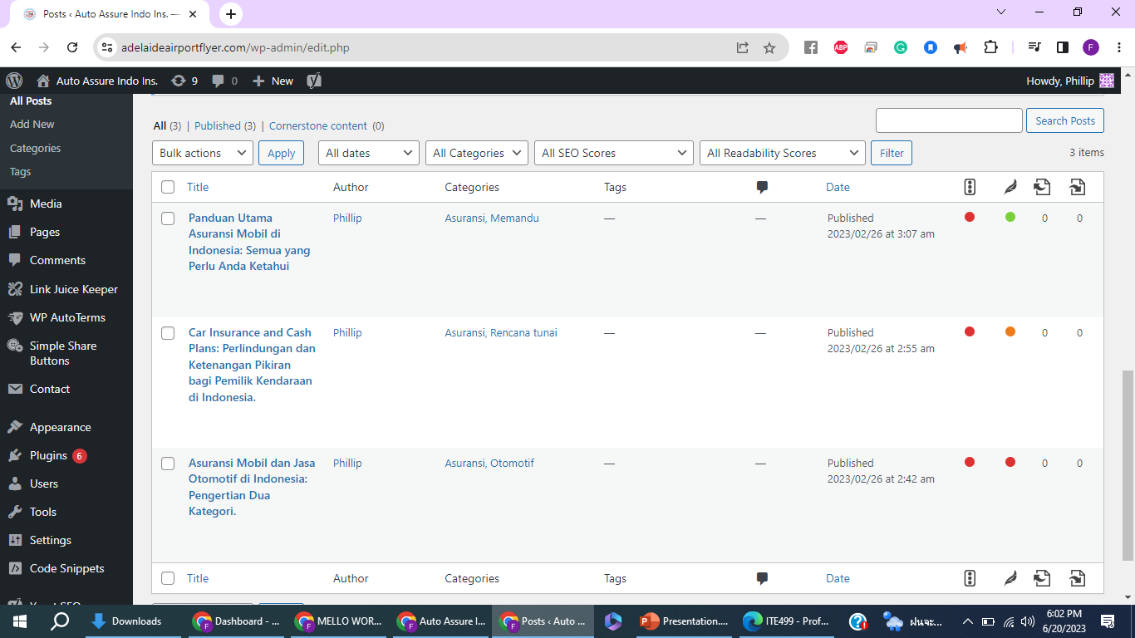
Posting articles along with suitable categories generated by AI tools on sites

Slide 21
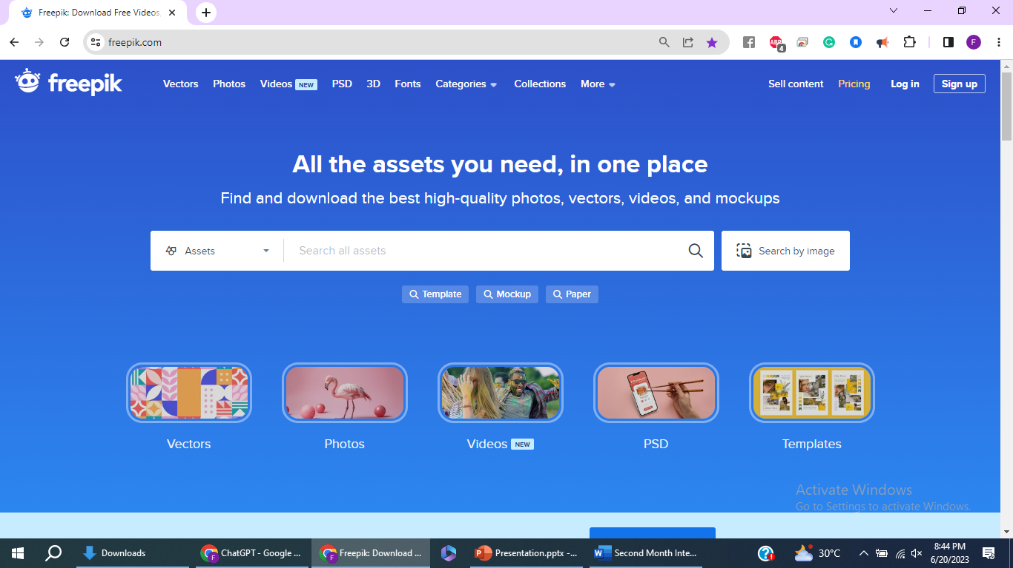
Using media e.g., images from Freepik mostly & other sites for choosing a suitable image for every article posting and following date of publishment of the articles on Wordpress set by senior developers

Slide 22
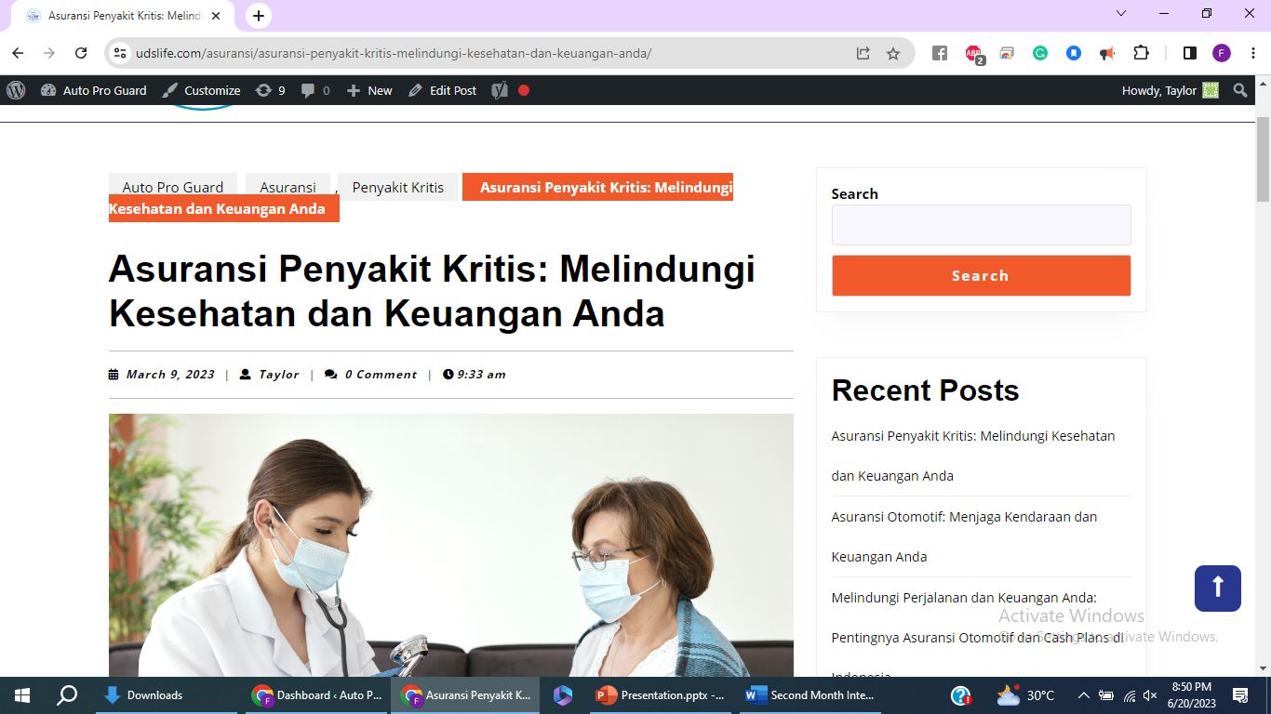
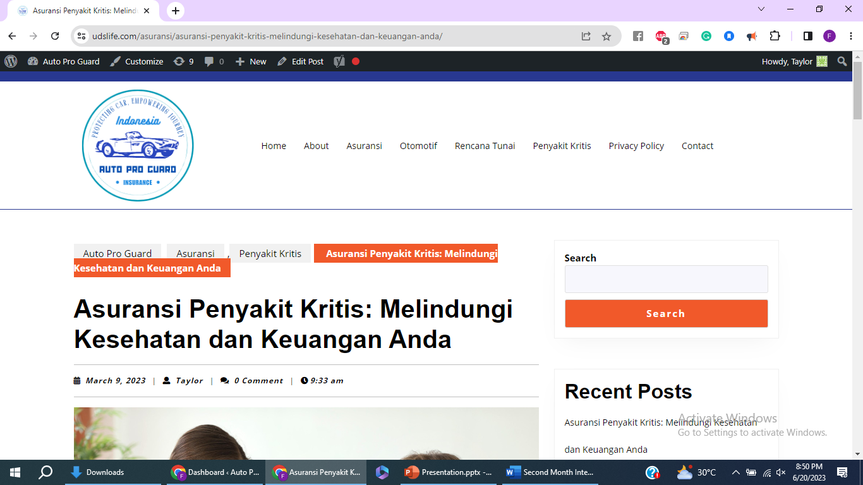
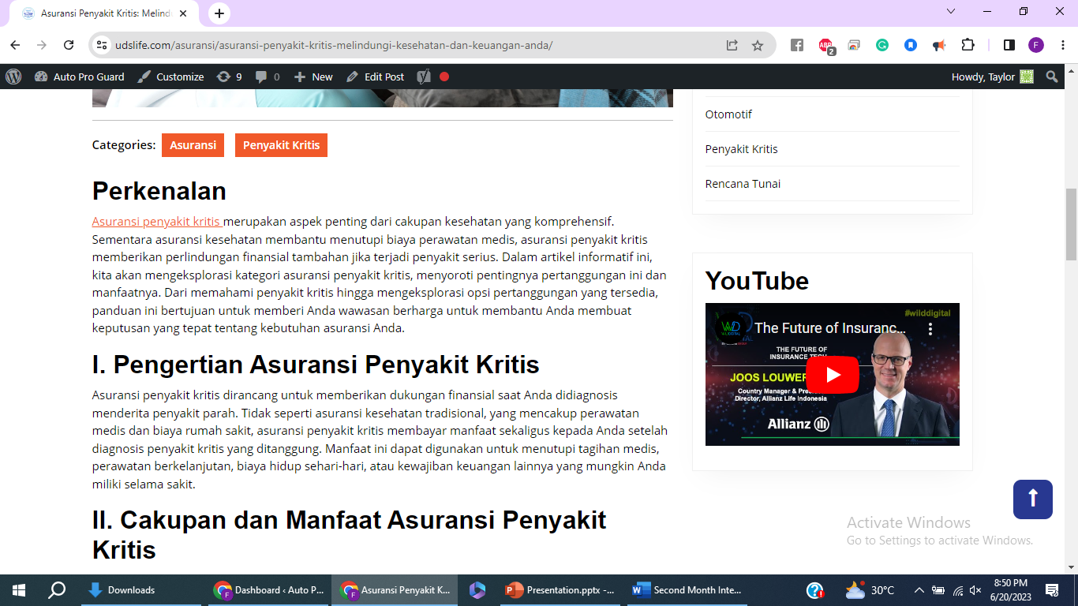
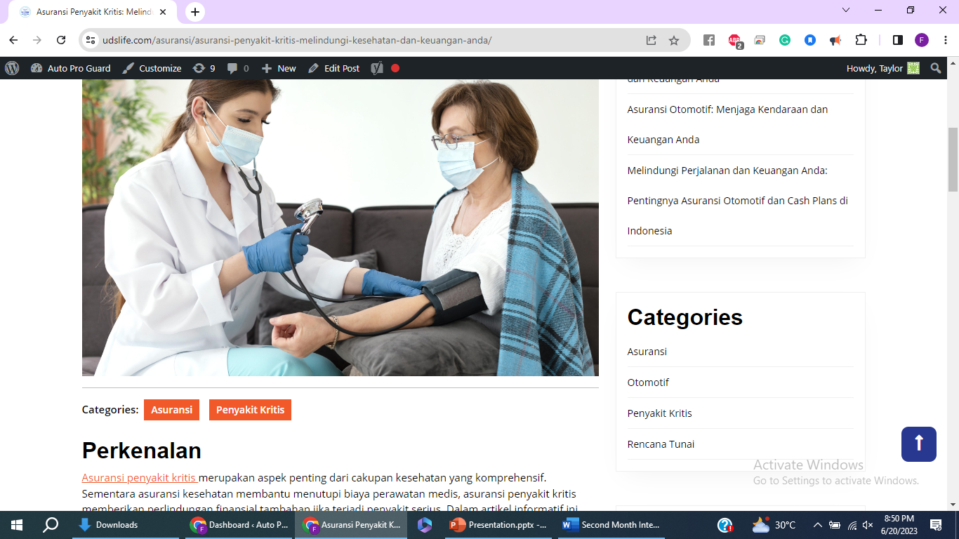
E.g., of article postings.

Slide 23
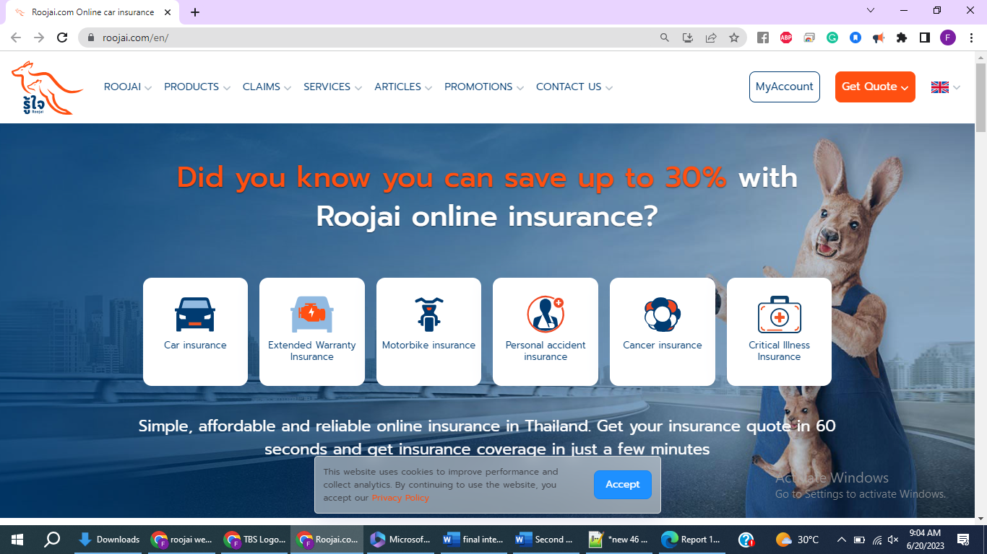
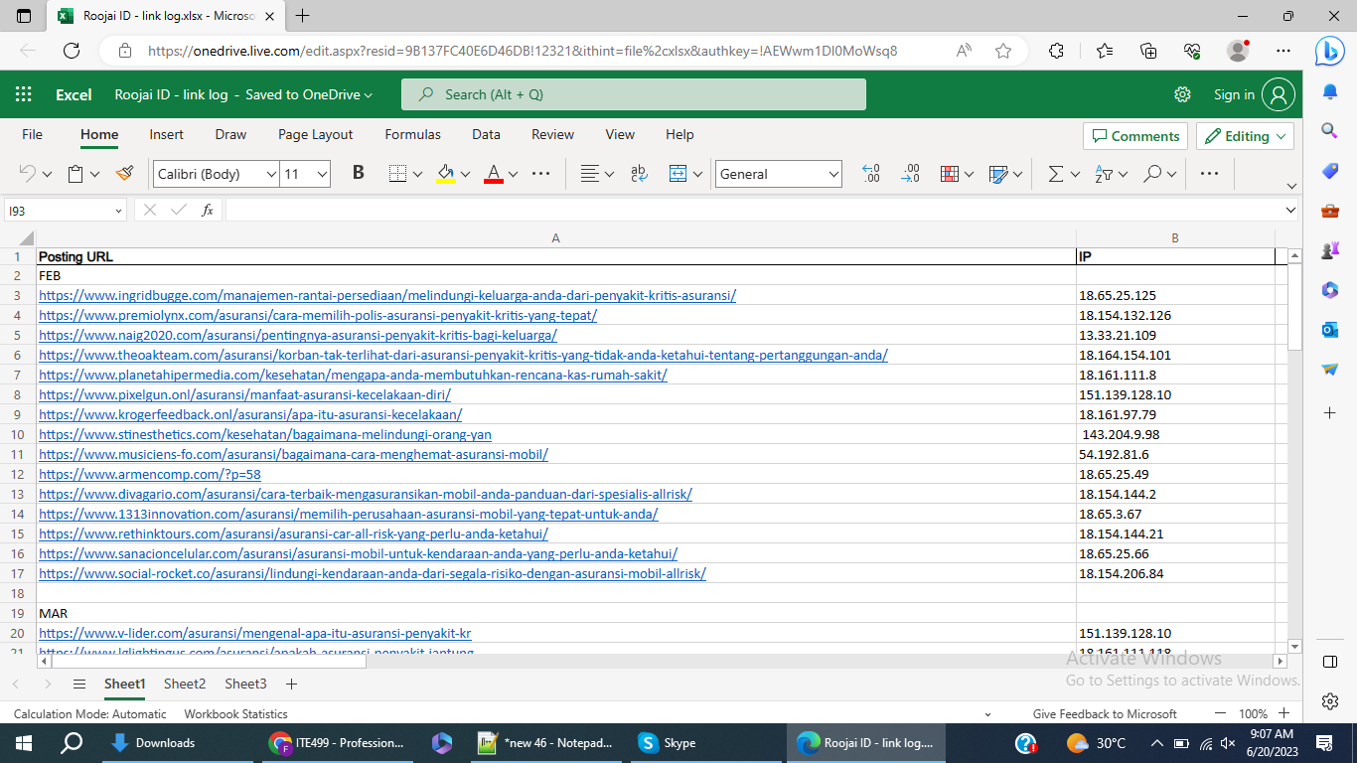
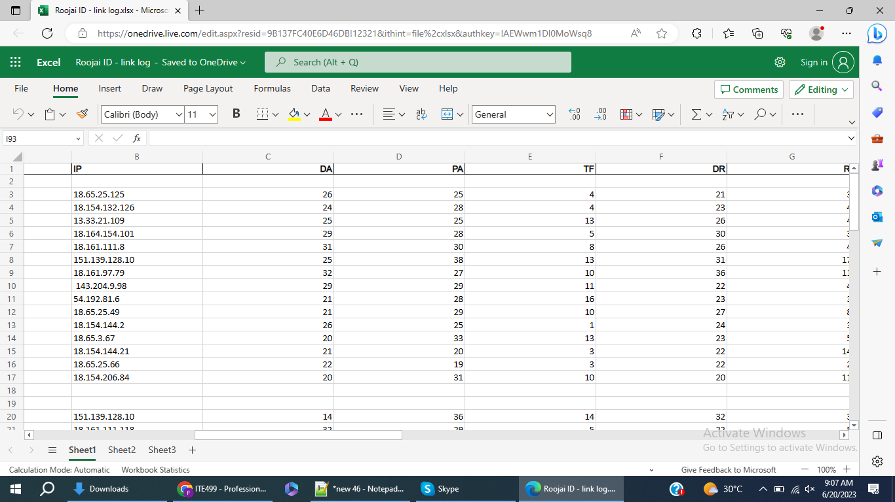
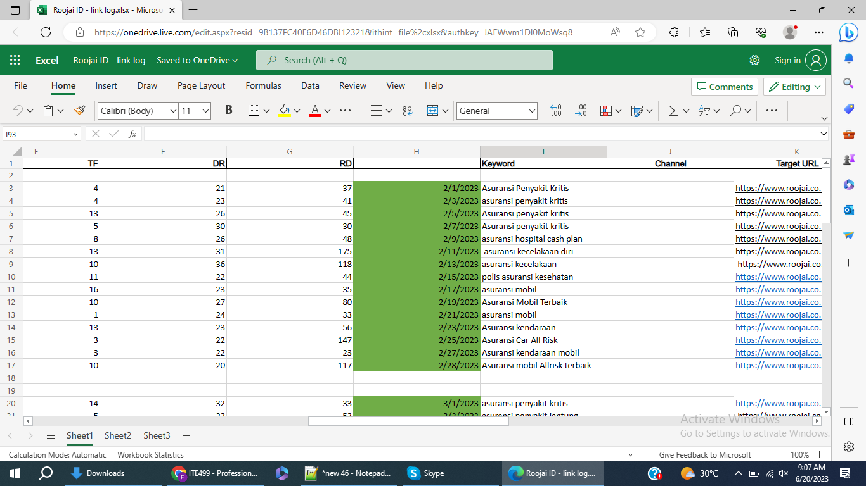
E.g., for Roojai step completion

Slide 24
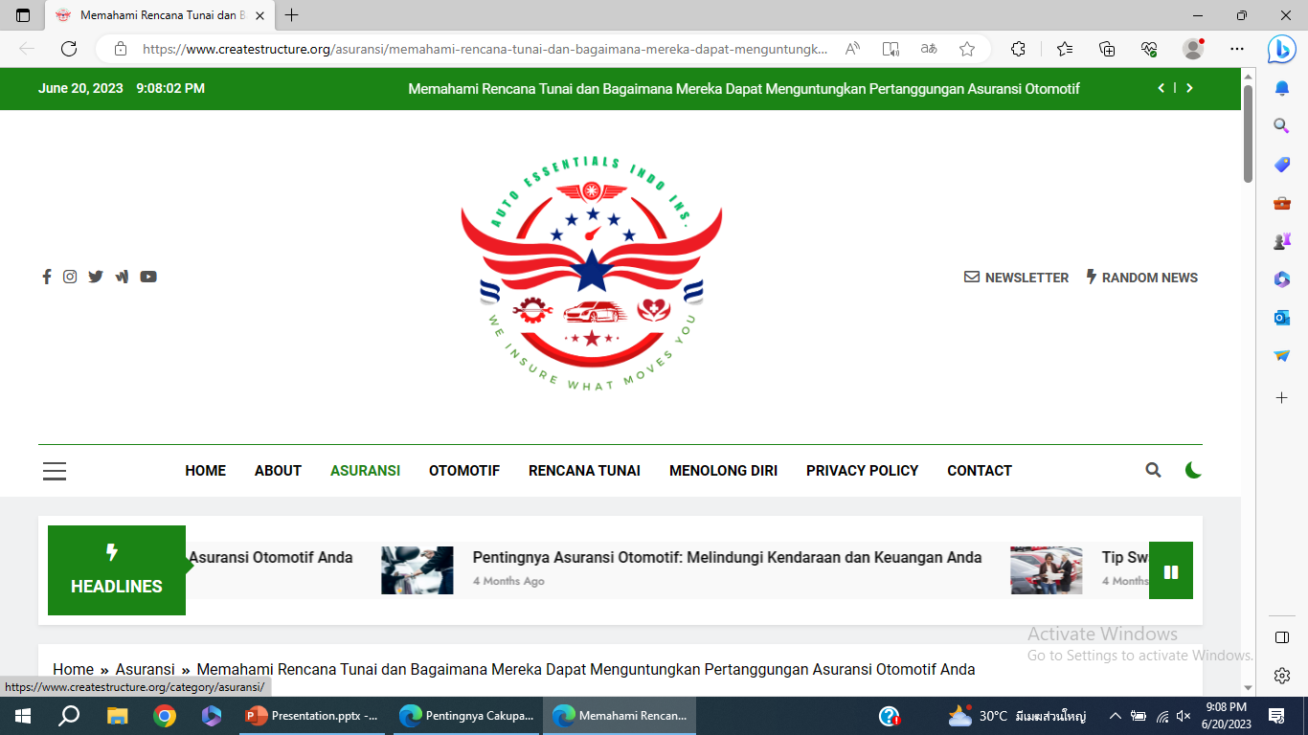
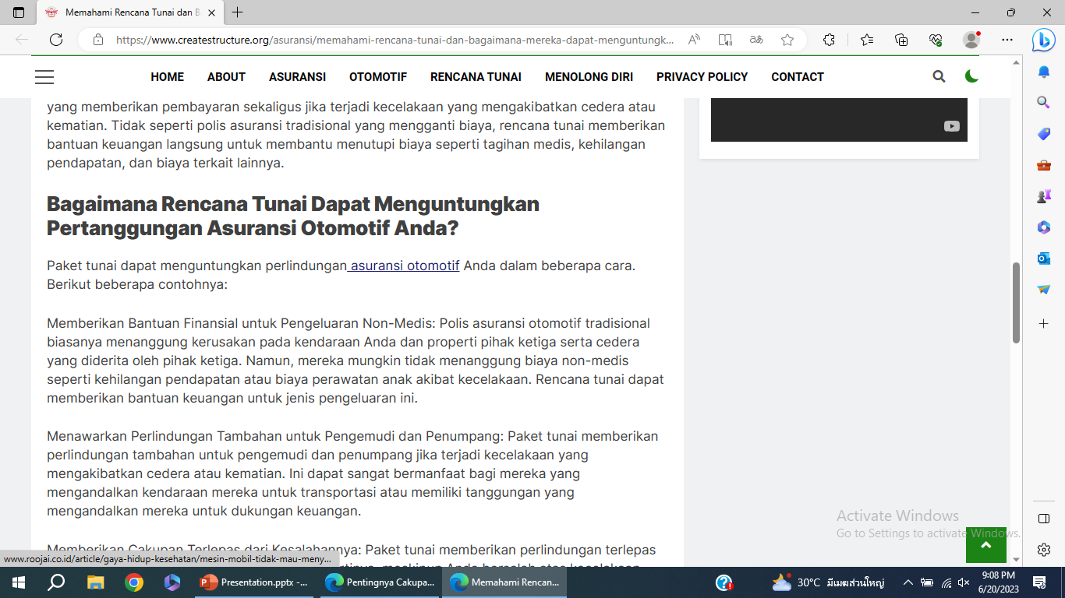
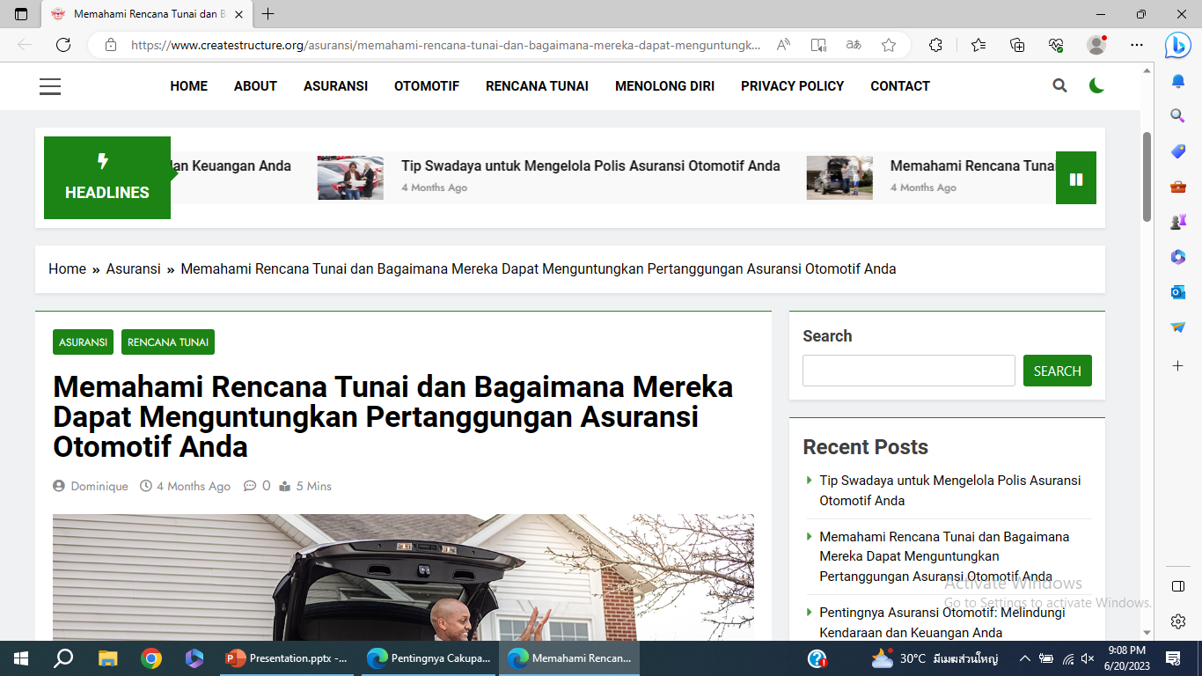
E.g., for Roojai step completion

Slide 25
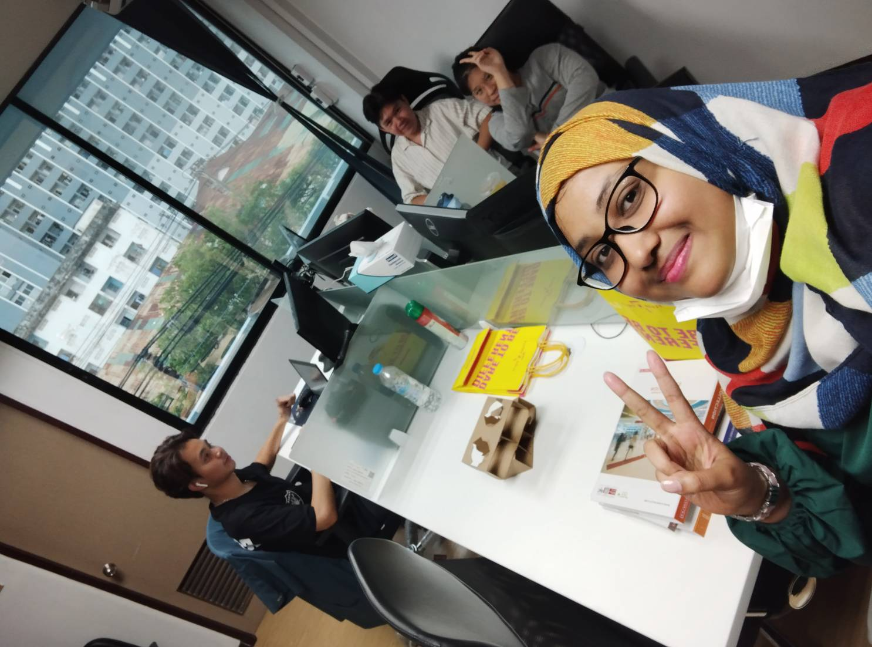
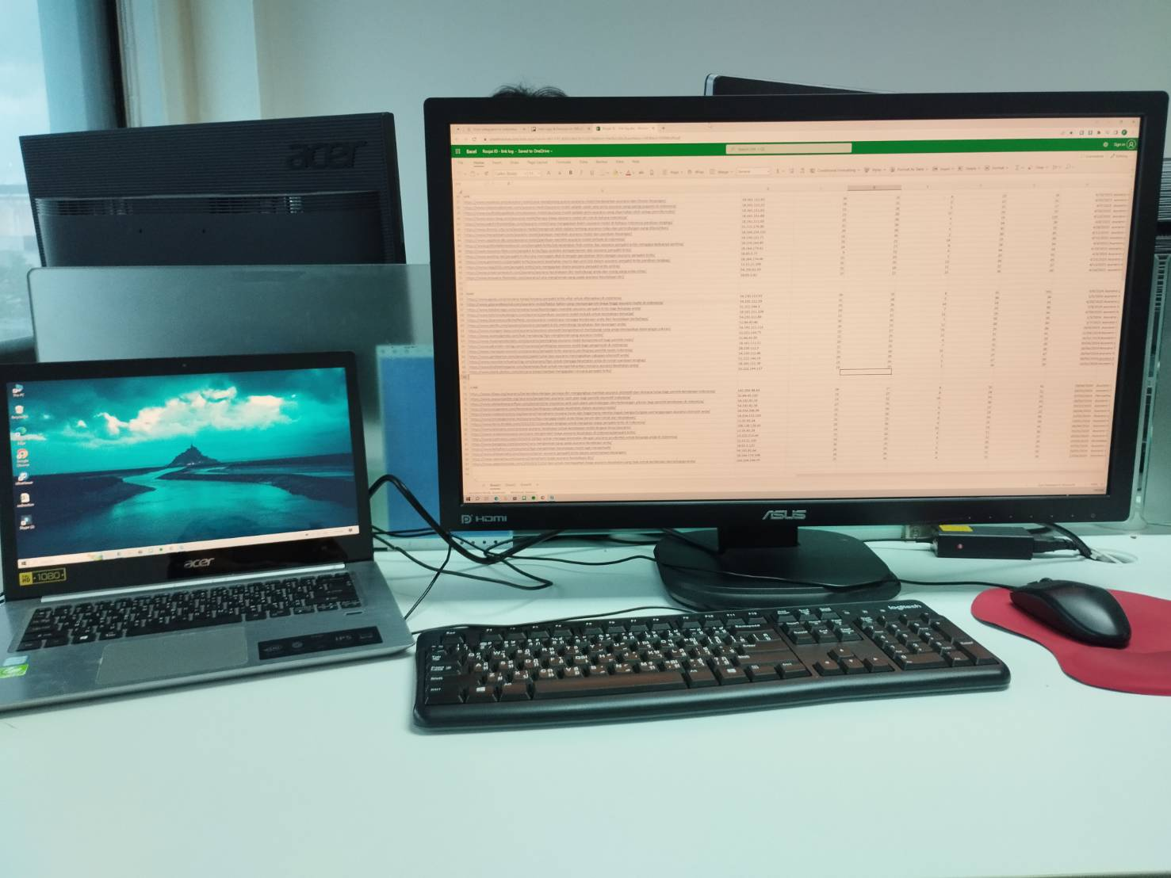
Conclusion Overall, my internship at TBS Marketing as a Web Developer, Web Designer, and Web Content Creator has been a valuable and fulfilling experience. Working on various website projects using WordPress, I gained hands-on experience in website design and development, collaborating with a talented team of professionals. Assisting in the updating of large sites further enhanced my skills and knowledge. I developed a standardized process for website development and design, ensuring consistency and efficiency. Throughout the internship, I improved my communication, attention to detail, and time management skills. Overall, this internship has provided me with a solid foundation in web development and design, and I am confident that the skills and experiences gained will benefit my future career in this field.
Pic with my IT senior team
Pic of my work area

Slide 26
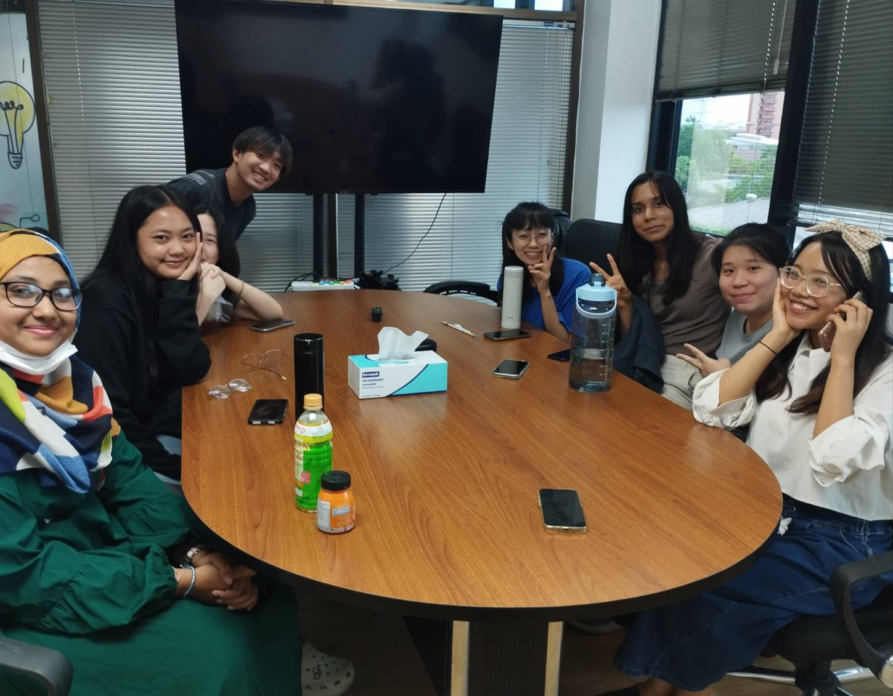
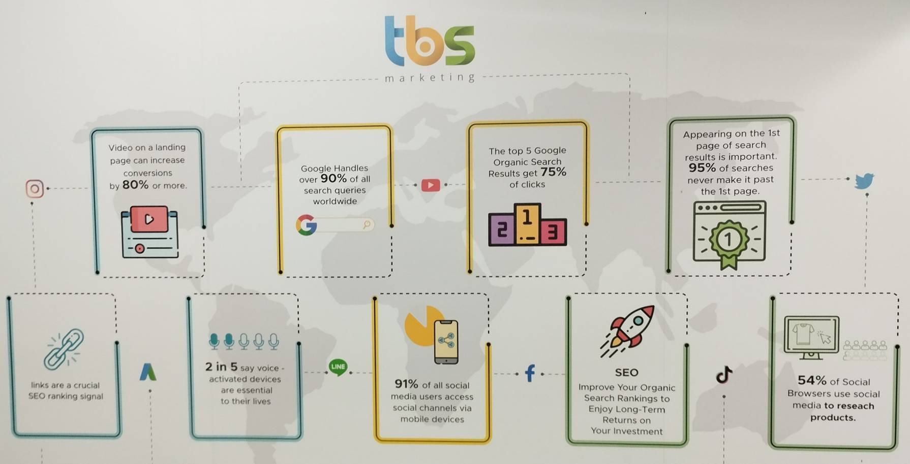
Pic with other staff
I---------------------------------------------------The End----------------------------------------------------------I

